Slide 1

First Key Argument
Inequality in the Technical Coding Layer

Slide 2


1.Inequality in the Technical Coding Layer
1）Algorithmic bias
Training data + Bias → Systematic discrimination
Companies typically refuse to disclose their logic under the guise of "trade secrets."
Amazon's AI recruitment tool

Slide 3

1.Inequality in the Technical Coding Layer
2）Technological monopoly
≥ 80% of global user data
Monopolize computing power
Leverage financial might
"Technological feudal system"
Core resources have become concentrated in the hands of a few corporate giants.

Slide 4
1.Inequality in the Technical Coding Layer
Problems in employment
Inequality in the Technical Coding Layer
Problems in social education

Slide 5
Third Key Argument
Inequality in the Education Layer

Slide 6


3.Inequality in the Education Layer
1）Personalized Learning

Slide 7

3.Inequality in the Education Layer
2）Automated grading

Slide 8
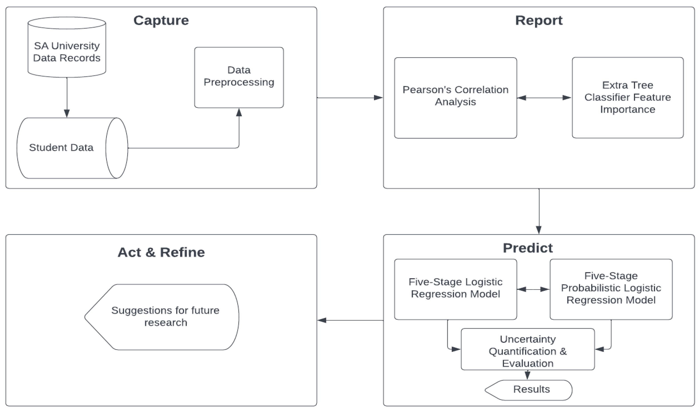
3.Inequality in the Education Layer
3）Predictive systems that identify at-risk students

